Slide 1
Data Communications Sessional
CSE 318 June 15

Slide 2
Topics to be covered
This Lecture:
Linear Code
Error Detection
Error Correction (Hamming Code)
Cyclic Code
CRC
Polynomials
Advantages
Implementation of algorithms

Slide 3
Introduction
Linear Code: A linear block code is a code in which the exclusive OR (addition modulo-2) of two valid codewords creates another valid codeword
Cyclic Code: A cyclic code is a codeword which if cyclically shifted, the result is another codeword

Slide 4
Introduction (Contd.)
Error Detection:
Detects Error
Does not fix the issue
Different types of error detection
Achieved through adding redundancy
Discards data with error
Can only detect one type of error at a time
Error Correction:
Detects the error
Fixes the error
Different types of error correction
Achieved through adding redundancy

Slide 5
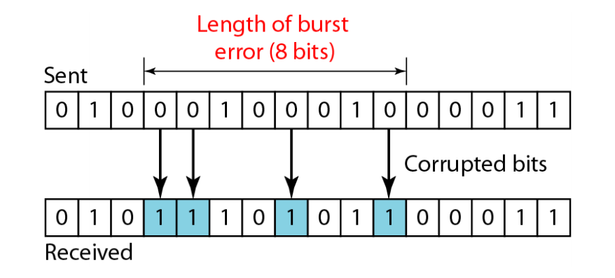
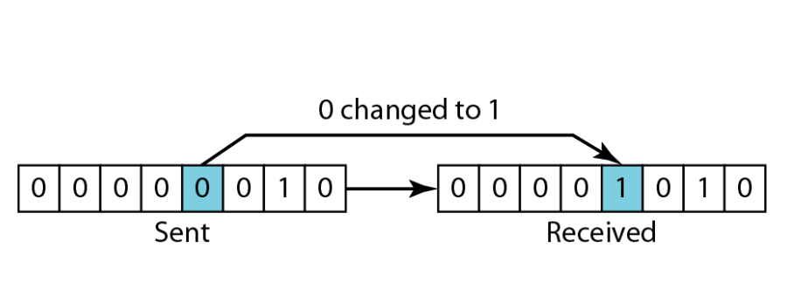
Error Types
Single Bit Error:
Single bit has changed
Easy to fix
Less likely
Burst Error:
2 or more bits have changed
More likely
Depends on what caused the change

Slide 6
Conditions for success
Conditions:
To guarantee the detection of up to s errors in all cases, the minimum Hamming distance in a block code must be dmin = s + 1 = 2
To guarantee correction of up to t errors in all cases, the minimum Hamming distance in a block code must be dmin = 2t + 1 = 3

Slide 7
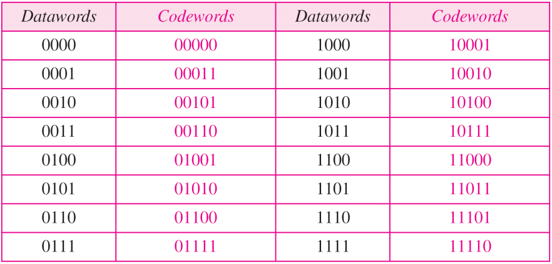
Parity Check

Slide 8
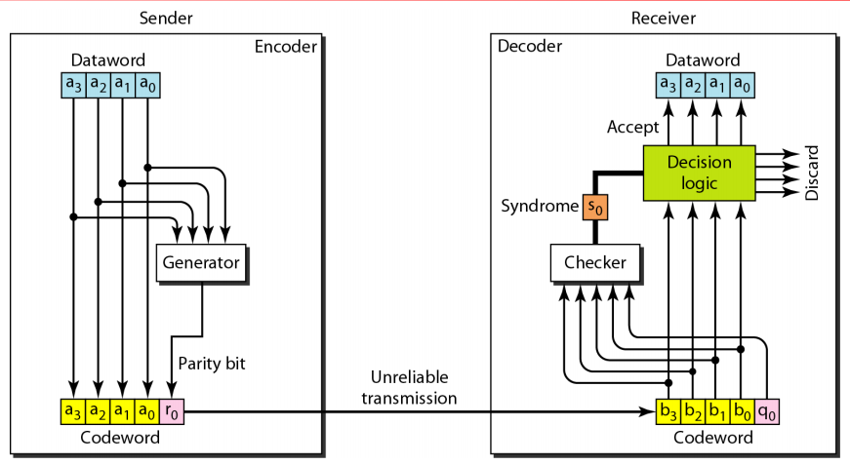
Parity Check (Contd.)

Slide 9
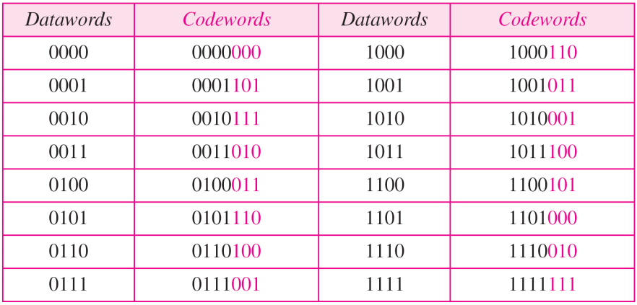
Hamming Code

Slide 10
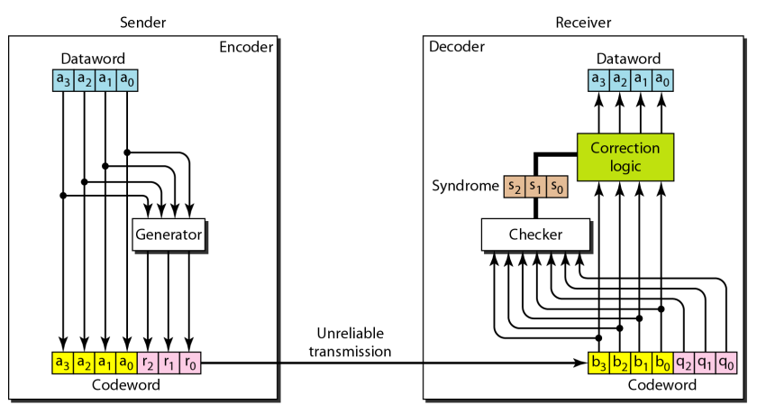
Hamming Code (Contd.)

Slide 11
Hamming Code (Contd.)
At sender end:
Modulo 2 arithmetic
r0 = a2 ⊕ a1 ⊕ a0
r1 = a3 ⊕ a2 ⊕ a1
r2 = a1 ⊕ a0 ⊕ a3

Slide 12
Hamming Code (Contd.)
At receiver end:
Modulo 2 arithmetic
s0 = b2 ⊕ b1 ⊕ b0 ⊕ q0
s1 = b3 ⊕ b2 ⊕ b1 ⊕ q1
s2 = b1 ⊕ b0 ⊕ b3 ⊕ q2

Slide 13

Hamming Code (Contd.)
At receiver end:
Modulo 2 arithmetic
s0 = b2 ⊕ b1 ⊕ b0 ⊕ q0
s1 = b3 ⊕ b2 ⊕ b1 ⊕ q1
s2 = b1 ⊕ b0 ⊕ b3 ⊕ q2

Slide 14
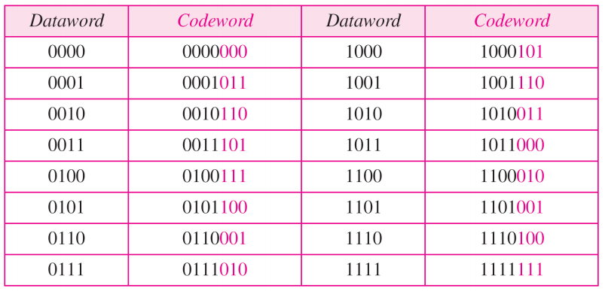
CRC

Slide 15
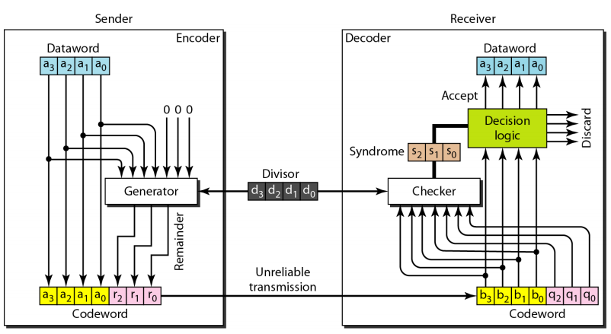
CRC (Contd.)

Slide 16
Reference Materials
‘Data Communications and Networking’ by Behrouza Forouzan
Videos to watch:
https://www.youtube.com/watch?v=X8jsijhllIA
https://www.youtube.com/watch?v=b3NxrZOu_CE
[to be added later]
Slide:
https://docs.google.com/presentation/d/1YyjIRaWlj96OOPHRc8potkikNWBId3rNGpzH2sd2As4/edit?usp=sharing
Notebook
https://colab.research.google.com/drive/1anztsUwUJjQY7N2-xRFwpq1FqMhZkjpY?usp=sharing

Slide 17
Thank you

Slide 18
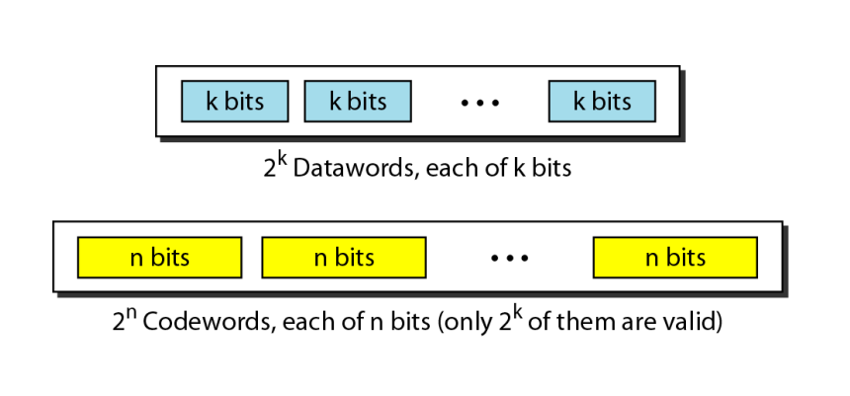
Extra
Definitions:
In block coding, we divide our message into blocks, each of k bits, called datawords.
We add r redundant bits to each block to make the length n = k + r.
The resulting n-bit blocks are called codewords.

Slide 19
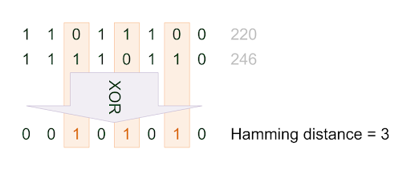
Extra (Contd.)
Hamming distance calculation:
The number of dissimilar bits between two perfectly aligned data bytes
Can be achieved through XOR operation
The minimum Hamming distance is the smallest Hamming distance between all possible pairs in a set of words

